Slide 1


Class Imbalance and Outlier Detection for Fraud Detection
Στέφανος-Δημήτριος Στεφανίδης
ΑΕΜ :20 (DWS)
stefanids@csd.auth.gr
Νικόλαος Μυλωνάς
AEM : 14 (AI)
myloniko@csd.auth.gr

Slide 2
Fraud Detection
Top Priority for banks and financial institutions
2017: 22.8 billion $ stolen in card fraud related cases worldwide
2021: is expected to get a lot worse
Problem can be address using machine learning

Slide 3
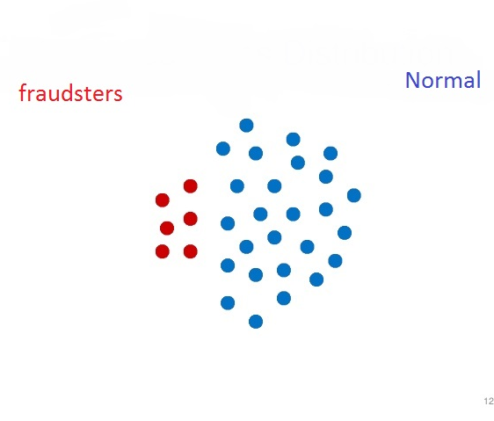
Fraudsters are a minority (below 1% in most occasions)

Slide 4
Techniques for Fraud Detection
Outlier Detection
Class Imbalance
Observation which deviate so much from other observations as to arouse suspicion it was generated by a different mechanism.
Fraudsters can be considered as outliers.
Since fraudsters are a minority finding them can be quite challenging.
Class imbalance algorithms reconstruct the training set to combat this problem.

Slide 5
Outlier Detection
Cluster-Based: outliers are data not belonging in any cluster.
Distance-Based: outliers are data whose distance from their neighbors is large.
Density-Based: outliers are data which belong in a low density region.

Slide 6
Algorithms
Algorithm | Type
Z-Score | Distance-Based
Dbscan | Cluster-Based
Local Outlier Factor(LOF) | Density-Based
OPTICS | Cluster-Based

Slide 7
Class Imbalance
Oversampling — SMOTE
Undersampling
Combined Class Methods — SMOTE + ENN

Slide 8
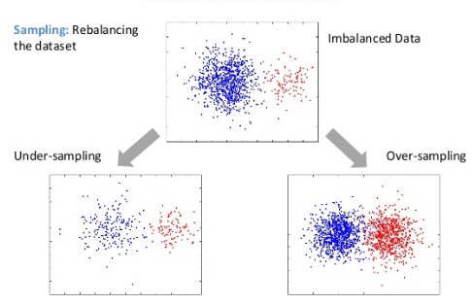
Class Imbalance

Slide 9
Algorithms
SMOTE: creates synthetic observations of the minority class.
Undersampling : works by sampling the dominant class to reduce the number of samples (EasyEnsample, BalanceCascade).
SMOTE+ENN: ENN ( Edited Nearest Neighbors) is used as the cleaning method after SMOTE over-sampling to obtain a cleaner space.

Slide 10
References
Data Mining The Textbook Charu C. Aggarwal
Accelerating the local outlier factor on a GPU for intrusion detection system
https://towardsdatascience.com/detecting-financial-fraud-using-machine-learning-three-ways-of-winning-the-war-against-imbalanced
https://towardsdatascience.com/a-brief-overview-of-outlier-detection-techniques
https://jair.org/index.php/jair/article/view/10302
Charu C. Aggarwal Outlier Analysis second edition
Exploratory Undersampling for Class-Imbalance Learning

